Slide 1
Backend Engineering-1 Project
Project Title
TEAM DETAILS:
SPARSH (TEAM LEADER) 2228(G25) sparsh2218.be23@chitkara.edu.in
VIVEK 2245(G25)vivek2245.be23@chitkara.edu.in
VIDI 2242(G25) vidhi2242.be23@chitkara.edu.in
VYOM 2228(G25) vyom2228.be23@chitkara.edu.in
Supervised By Batch-2023; G-25; Semester - III
Dr. Sikha
:
Chitkara University Institute of Engineering and Technology,
Chitkara University, Punjab

Slide 2
Introduction
Our project demonstrates the basics of backend development by integrating a registration form with a simple data storage and retrieval system. User-submitted data is saved to a JSON file, which serves as our database, and is later fetched to be displayed on a separate page. This project showcases foundational concepts of data handling and serves as an entry point to more advanced backend applications.

Slide 3
Key Learnings
Data Handling Basics: Understanding how to capture and store user input in a structured format (JSON).
File Operations: Learning to write data to and read data from a file using backend technologies.
Frontend-Backend Interaction: Exploring how the frontend communicates with the backend to send and fetch data.
HTTP Requests: Using basic HTTP methods (POST and GET) to handle data transfer.
JSON Manipulation: Working with JSON as a lightweight data storage solution.
Dynamic Content Rendering: Displaying stored data dynamically on another page.

Slide 4
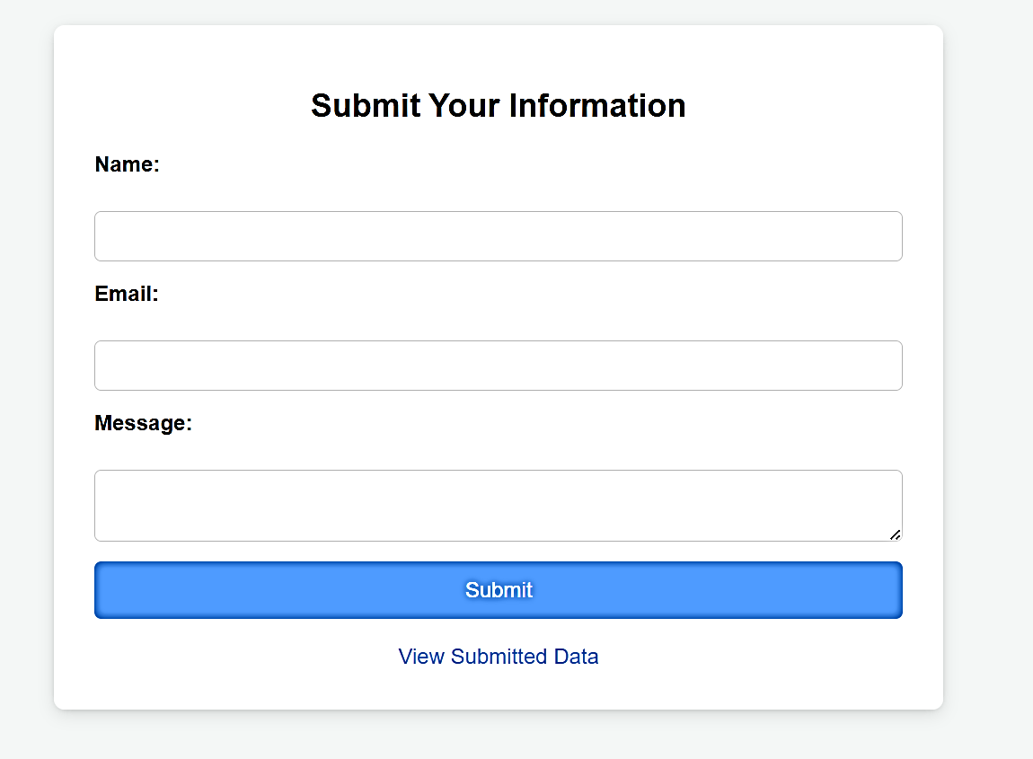
Output
Fig 1. Registration Page
In this page we will take data from the user which will then save into local storage on clicking “Submit Button”

Slide 5
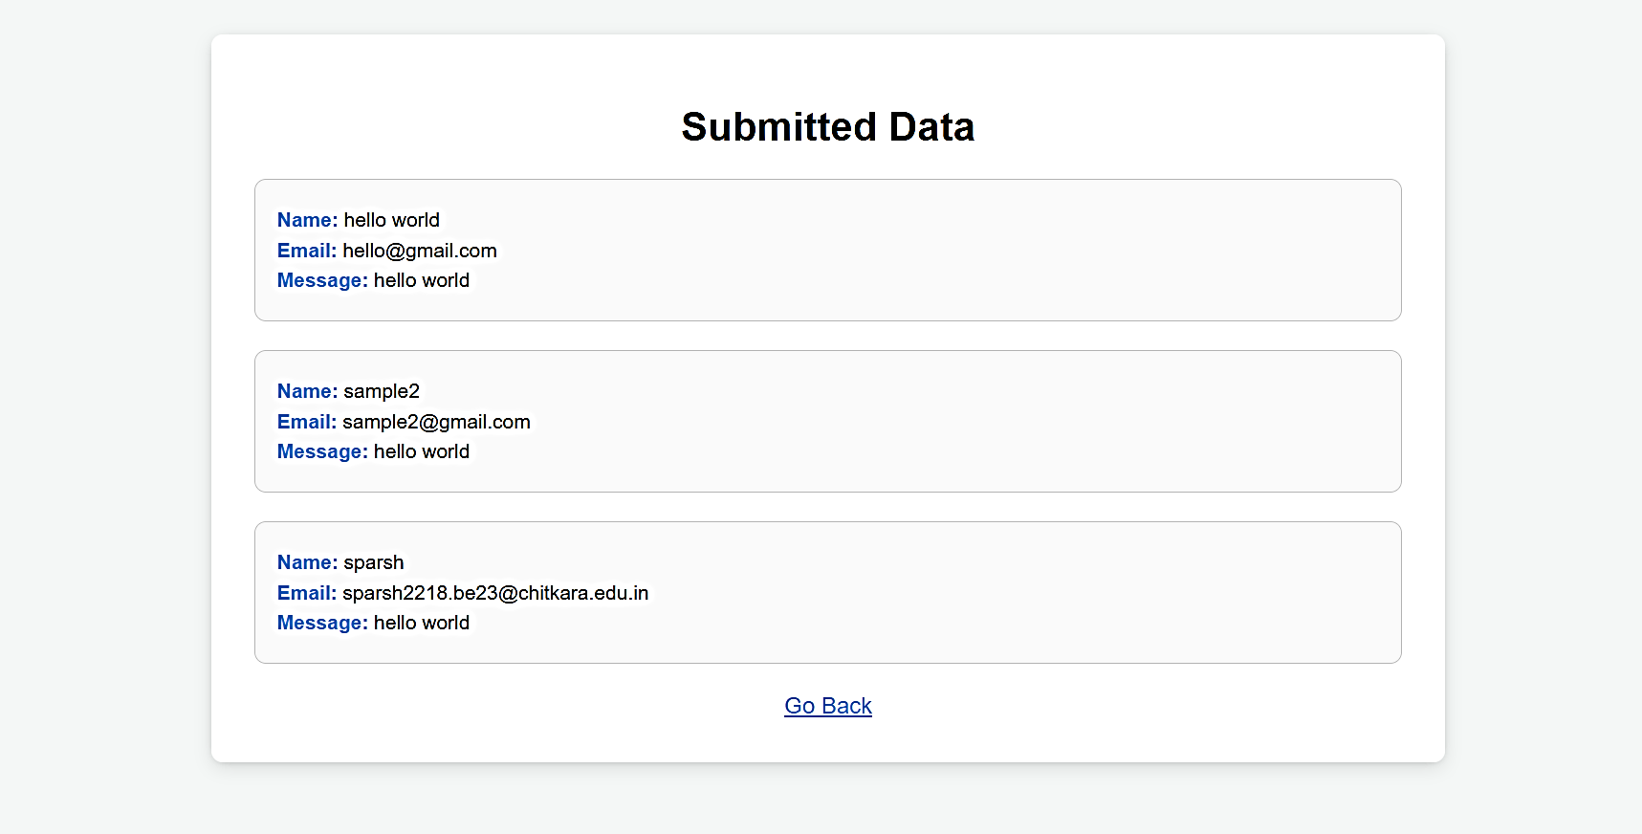
Output
Fig 2. Fetched Data

Slide 6
Conclusion
In conclusion, this project serves as an excellent introduction to backend development, demonstrating the fundamental processes of data capture, storage, and retrieval. By working with a registration form, JSON files, and basic HTTP methods, we gained hands-on experience in connecting frontend and backend components. This foundational knowledge sets the stage for exploring more advanced backend systems and full-stack development

